Slide 1
Computer Science Project Vidhi Gupta 12-B Topic:- ATM Management System
Roll No.-

Slide 2
Index
Certificate
Acknowledgement
Introduction
System requirements
Project Front end & Back end
DBMS : My SQL
Python Codes
Outputs
Bibliography

Slide 3
Certificate
This is to certify that Ms.Vidhi Gupta of class 12 section B has successfully completed her computer science project on topic ATM Management System under the guidance of Mrs.Vinuka
Mrs.Vinuka
(Subject Teacher)

Slide 4
Acknowledgement
I would like to express my special thanks of gratitude Ms.Vinuka who gave me the golden opportunity to do this CS Project on ATM management system, who also helped me in completing my project . I came to know about so many new things I really thankful to them . Secondly I would also like to thank my parents and friends who helped me a lot in finalizing this project within the limited time frame.

Slide 5
Introduction
The aim of the ATM management system project is to build a python based ATM management system. The introduction of ATM’s by various banks have brought about freedom from the interminable queues in front of withdrawal counters at banks. This ATM management system requires the constant updating of records between the bank servers and a spread out network of ATMs.
The ATM Management System is a very productive management system for registering the data of the people and creating a smooth process for the same.

Slide 6
The program has the following options:
1)To create account
2)To login
Depositing money
Withdrawing money
Transferring money
Checking balance
Changing account number
3)Exit

Slide 7
System Requirements
Hardware specification:
Processor: AMD Ryzen 5 3450U with Radeon Vega Mobile Gfx 2.10 GHz
Disc space: 1GB
Software specification:
Operating system: Windows 10
Python version: 3.8 or higher
MYSQL Version:

Slide 8


Project Front end and
Back end
Front End: Python
Bach End: MYSQL

Slide 9
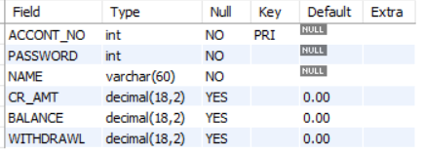
DBMS:MYSQL
MYSQL Commands:
CREATE TABLE records
(
ACCONT_NO INT NOT NULL,
PASSWORD INT NOT NULL,
NAME VARCHAR(60) NOT NULL,
CR_AMT DECIMAL(18,2) default 0,
BALANCE DECIMAL(18,2) default 0,
WITHDRAWL DECIMAL(18,2) default 0,
PRIMARY KEY(ACCONT_NO)
);
Structure of Database:

Slide 10
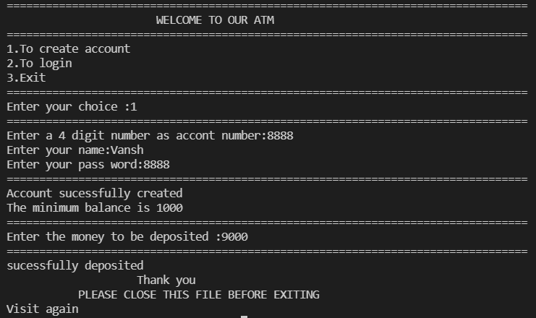
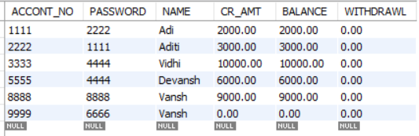
Outputs
1)To create account

Slide 11
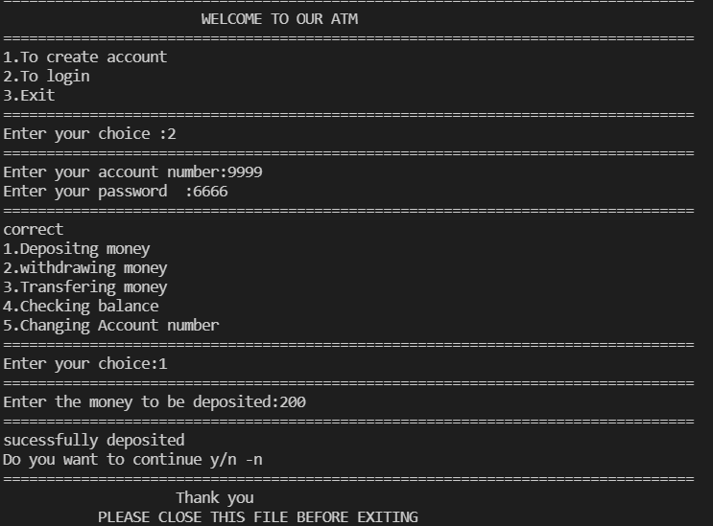
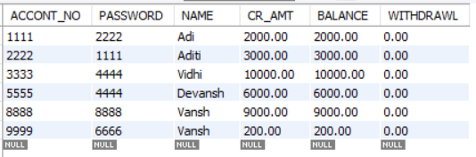
2)To login
Depositing money

Slide 12
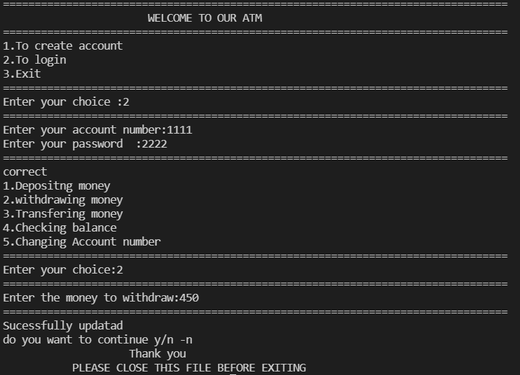
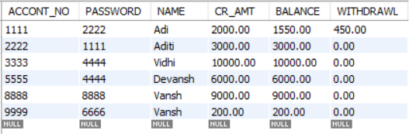
Withdrawing money

Slide 13
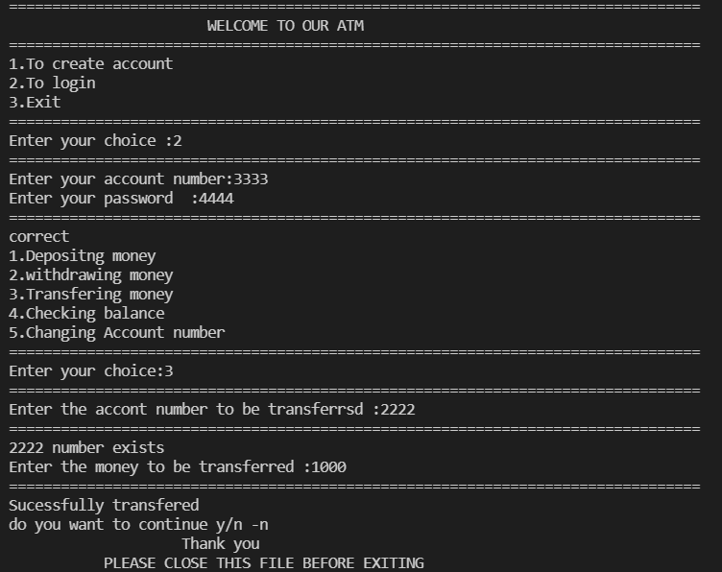
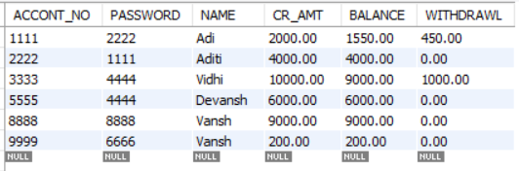
Transferring money

Slide 14
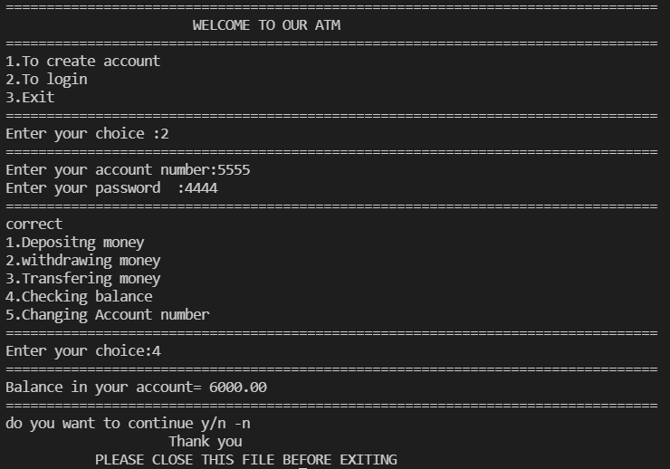
Checking balance

Slide 15
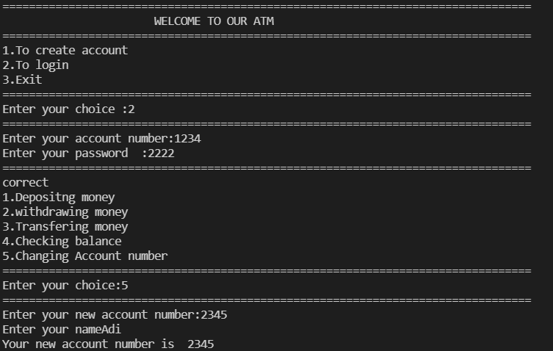
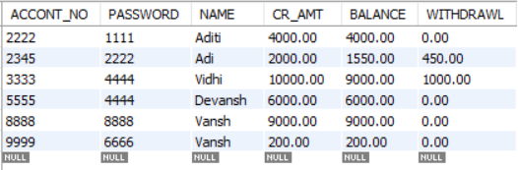
Changing account number

Slide 16
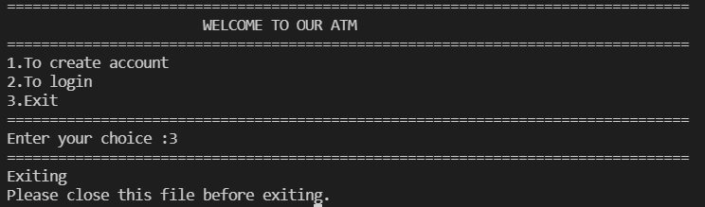
3)Exit

Slide 17
Bibliography
https://www.mysql.org/
http://www.python.org/
Computer science for class XII- by sumita arora
Together with computer science

